Slide 1
CGIC / NIBIN 101
From Crime Gun Evidence to Actionable Intelligence
[AGENCY / PROGRAM NAME] • [TRAINING DATE] • [PRESENTER]

Slide 2
What You Should Know by the End
What the National Integrated Ballistic Information Network (NIBIN) is and what it is not.
What crime gun evidence can contribute to the NIBIN process.
How digital acquisitions and correlation reviews can generate NIBIN leads.
How a Crime Gun Intelligence Center (CGIC) turns that lead into usable investigative intelligence.
Why patrol, timeliness, and local procedures matter.

Slide 3
What Is NIBIN?
THE BASIC IDEA
  When a firearm is fired, microscopic toolmarks can be transferred to the cartridge case.
  NIBIN captures digital images of those markings and compares them with other entries.
WHAT IT CAN REVEAL
  Potential associations between shooting incidents.
  Potential associations between a recovered firearm and ballistic evidence from another event.
  Connections that may cross cases, units, agencies, or jurisdictions.

Slide 4
What Evidence Enters the Process?
CARTRIDGE CASES
  Cartridge cases recovered from shooting scenes may contain firearm-produced markings that can be imaged and compared.
CRIME GUNS
  Recovered firearms can be test-fired. The resulting cartridge cases may be acquired into NIBIN and compared with other ballistic evidence.

Slide 5
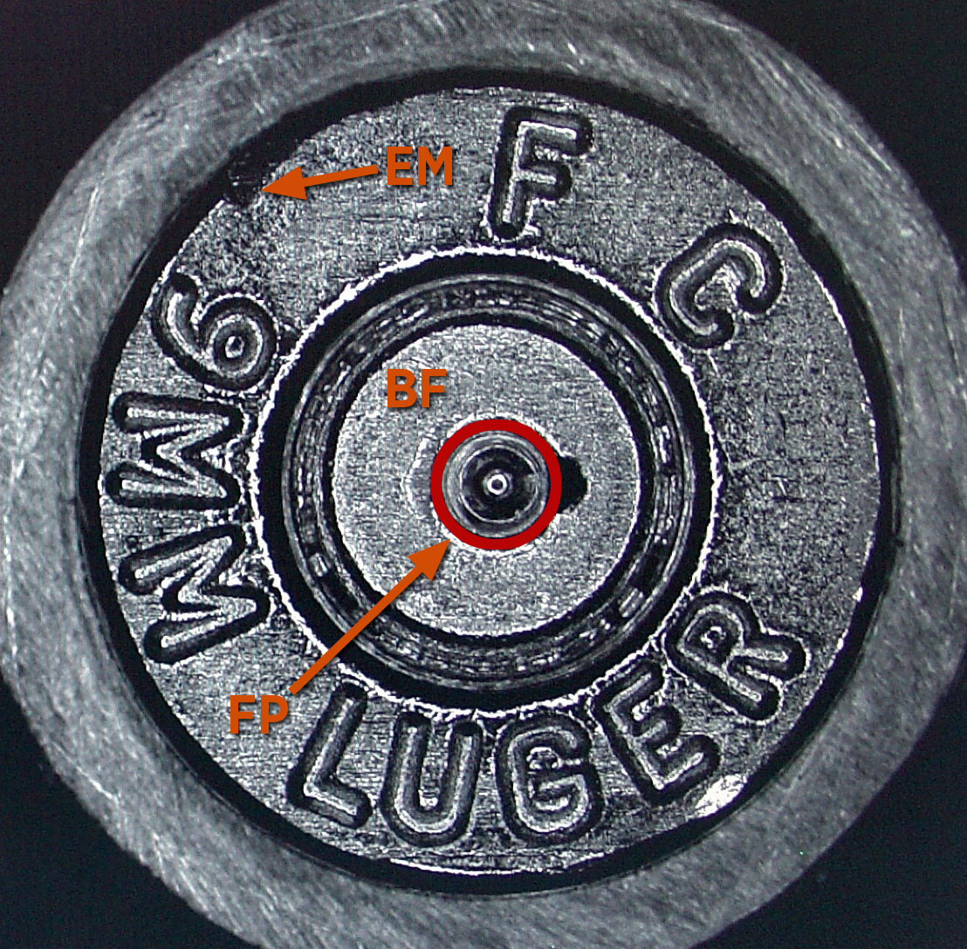
What Does NIBIN “See”?
FIRING PIN IMPRESSIONS
BREECH-FACE MARKS
EJECTOR MARKS
These are examples of firearm-produced markings that can appear on a fired cartridge case.
* Image from the Bureau of Alcohol, Tobacco, Firearms and Explosives (ATF)

Slide 6
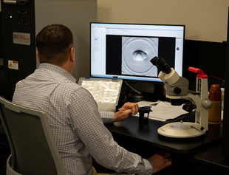
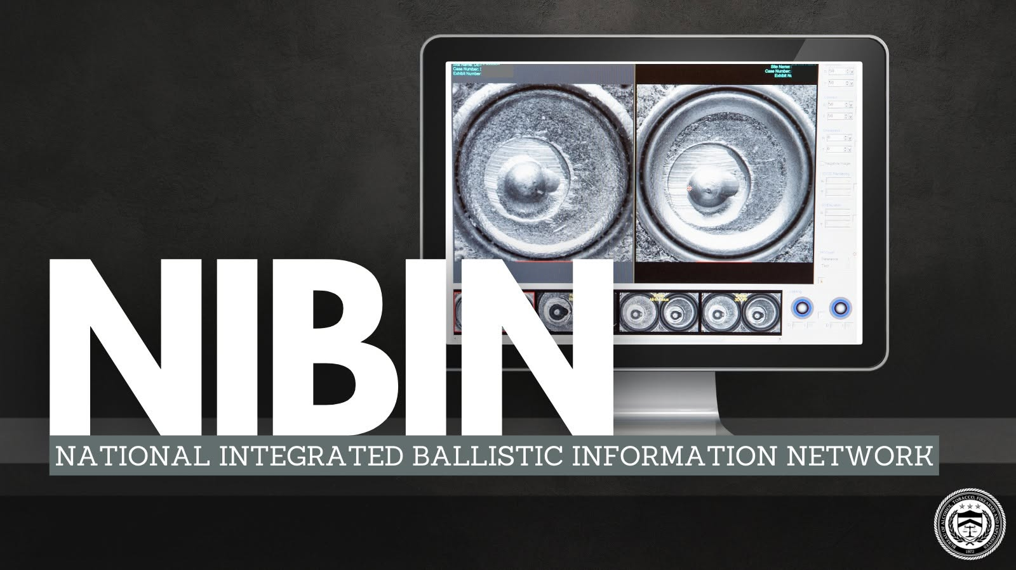
From Cartridge Case to NIBIN Lead
ACQUISITION
Digital images of eligible cartridge case evidence are acquired into the system.
AUTOMATED COMPARISON
The system returns ranked possible associations for trained review.
CORRELATION REVIEW
A trained reviewer compares digital images and determines whether a potential association should be reported as a NIBIN lead.
* Images from the Bureau of Alcohol, Tobacco, Firearms and Explosives (ATF)

Slide 7
A NIBIN Lead Is Not a Forensic Confirmation
NIBIN LEAD
  An unconfirmed potential association identified through digital image correlation review.
  Used as investigative intelligence.
  Can help focus or connect investigative activity.
  Firearm equivalent to a drug field test kit.
FORENSIC CONFIRMATION
  When confirmation is required, a qualified firearms examiner compares the physical evidence microscopically.
  A confirmed association is distinct from the investigative NIBIN lead.

Slide 8
Where the CGIC Fits
CRIME GUN EVIDENCE → TIMELY PROCESSING → NIBIN LEAD
ANALYSIS + INTELLIGENCE → INVESTIGATIVE FOLLOW-UP → ACTION
NIBIN can identify a potential connection. The CGIC brings together the people, processes, technology, and partnerships needed to make that connection useful.

Slide 9
Example: The Connection Was Not Visible at the Scene
MONDAY — Shots-fired call. Cartridge cases recovered. No suspect identified.
THURSDAY — A second shooting occurs. Additional cartridge cases are recovered.
SATURDAY — A firearm is recovered during an unrelated enforcement encounter.
NIBIN — Potential ballistic associations are identified among the evidence.
CGIC / INVESTIGATORS — Previously separate events can now be assessed together.
* ILLUSTRATIVE EXAMPLE — NOT AN ACTUAL CASE

Slide 10
Why Timeliness — and Patrol — Matter
PATROL STARTS THE PROCESS
  Recognize potentially valuable crime gun evidence.
  Preserve and document it.
  Submit it according to local procedure.
  Communicate urgent circumstances when applicable.
THE VALUE OF INTELLIGENCE CHANGES WITH TIME
  A lead received while a case is active may influence decisions that the same lead cannot influence days or weeks later.
  Every handoff matters: collection, submission, processing, dissemination, and follow-up.

Slide 11
Make This Training Local
YOUR AGENCY’S PROCESS
[What evidence is NIBIN-eligible?]
[Where/how should it be submitted?]
[Packaging or impound requirements?]
[Urgent/after-hours procedure?]
YOUR LOCAL CONTACTS & RESOURCES
[CGIC/NIBIN unit]
[Evidence/property contact]
[Investigative contact]
[Local policy/resource link]
THE TAKEAWAY: The connection may not be visible at the scene. Getting the evidence into the process makes the connection possible.

